Slide 1

Oracy at St Botolph’s
“Learning floats on a sea of talk”
Evidence based research:
Education Recover Plan
EEF’s Covid support guide for schools

Slide 2
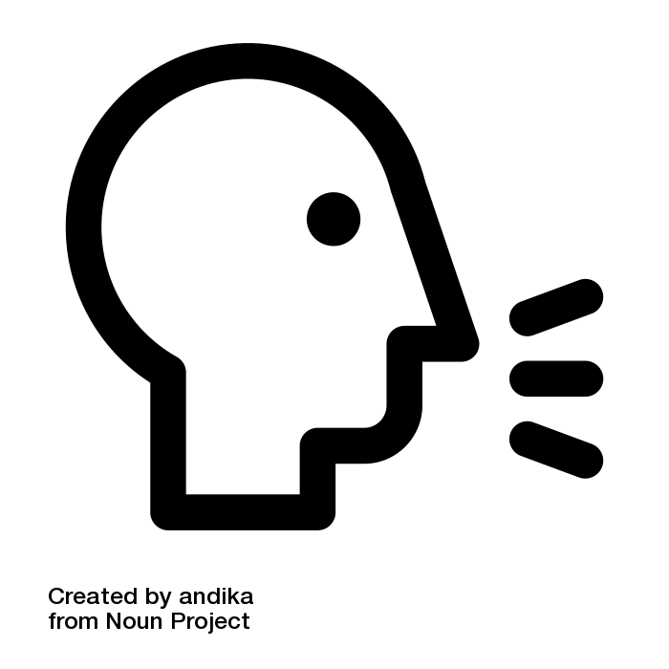
What is oracy? To articulate ideas, develop understanding and engage with others through spoken language.
Why is it so important?
Do we deliberately create opportunities for talk?
Do we continue the speaking drive after EYFS?
Which children know more than they say?
Deliberate talk or incidental talk?
Are we a communication friendly school?
Edutopia – Speaking is just as important as reading and writing. If they can’t orally construct a sentence, writing will always be a challenge.

Slide 3
St Botolph’s Early Language
Intent
Every child being a confident and articulate speaker.
Aims:
Teachers understand the importance of spoken language.
Early identification of those children at risk.

Slide 4
Talk more, read more.
At St Botolph’s we are…
Illustrators
Publishers
Authors
Researchers
Talkers
Talker for life.
Every child should speak in every lesson, everyday.

Slide 5
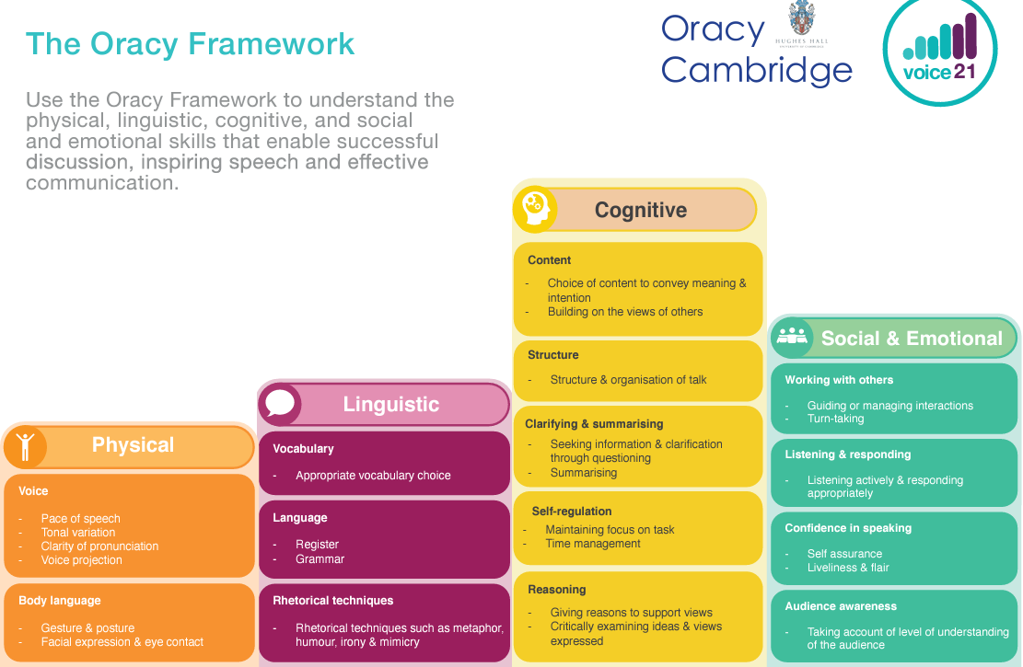

Slide 6
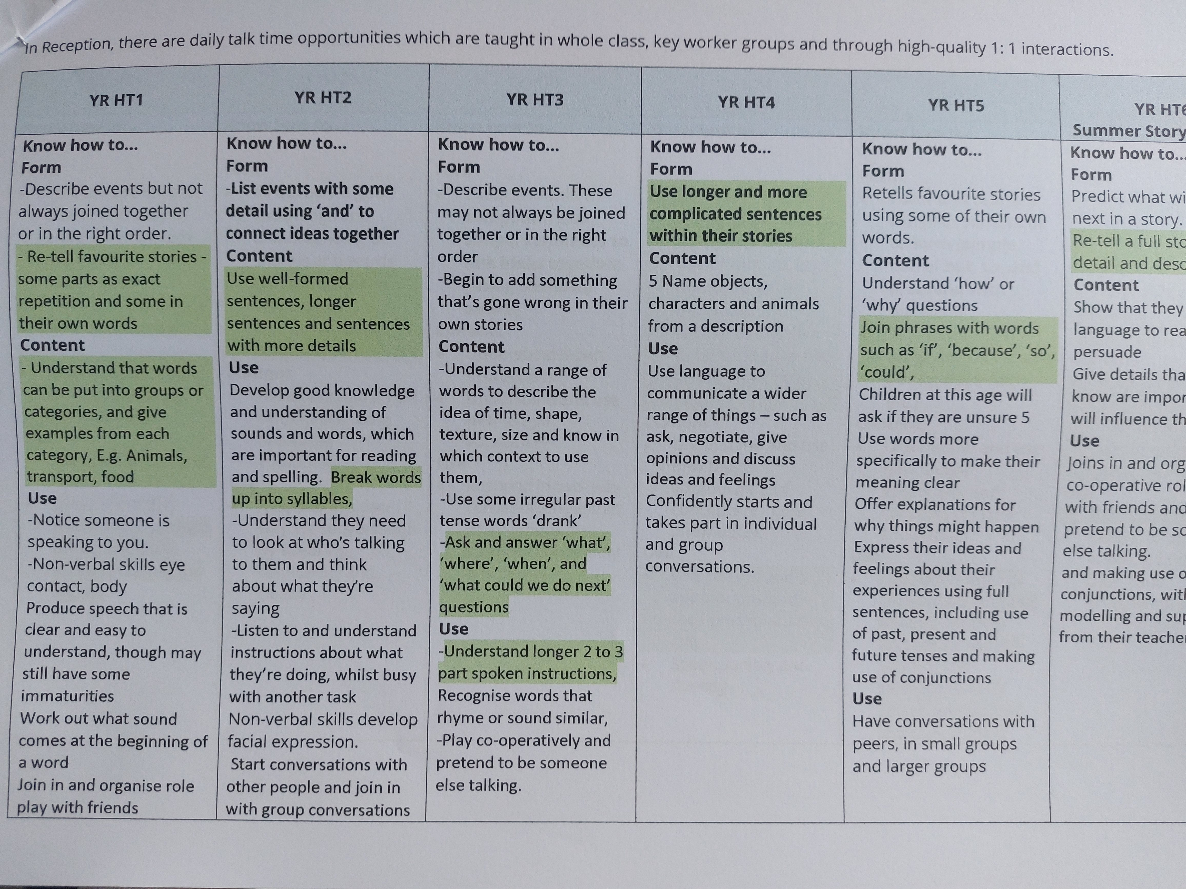
Oracy across the curriculum

Slide 7
Impact – supporting talk in school
Evidence shows that early intervention and oracy development can lead to:
Lower levels of unemployment
Improved mental health in adulthood
Access further education and training
Social and economic engagement
Improved levels of academic retention
Evidence based research:
Education Recover Plan
EEF’s Covid support guide for schools

Slide 8
Strategies
No hands up approach
“I heard Ellie say…”
TOL/TTYP/MTYT
Repeat. Rephrase. Extend.

Slide 9
Links
Infant language links – EYFS baseline (next steps and gaps)
‘Tools in the box’ – EYFS
Voice 21 Oracy framework - https://voice21.org/what-is-oracy/
EEF ShREC approach – high quality interactions with young children
RWI portal – Talk Through stories
WELLCOMM
“When we know better, we do better.”

