Slide 1
OPAL –ST Botolph’s C E Academy
Our vision

Slide 2
OPAL Vision (Outdoor play and learning)
-transform outside so there is lots to do for all children
-visually appealing
-all children (KS1 and KS2) mixing together
- field used all year round (Must have wellies in the winter/ when wet)

Slide 3
Reflective screen on wall / stage
Chalkboard
Map
Wellie
Storage
Football zone
UKS2
Tree – seats around
Tree – bark around bottom
Ks1 entrance – seating area/ snug / herb garden
Key Stage 2 playground

Slide 4
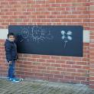
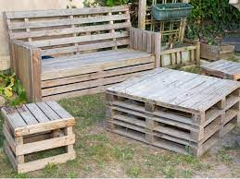
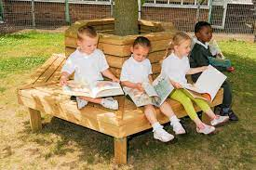
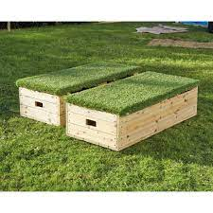
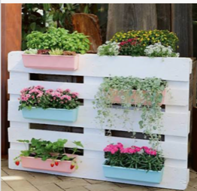
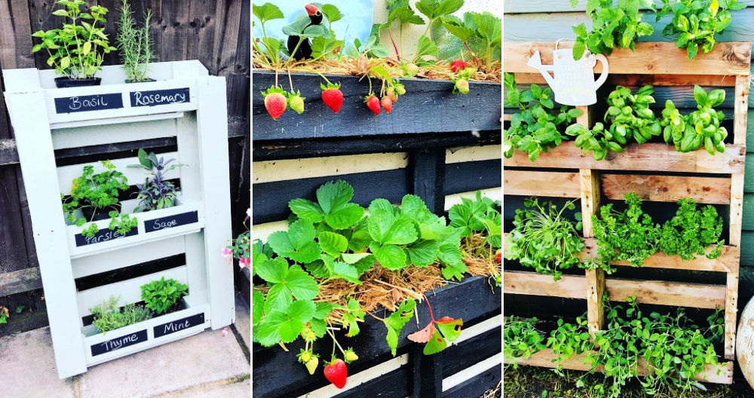
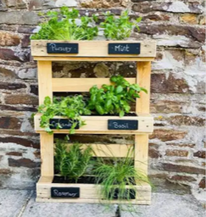
KS2 vision
With Astro turf on top
Seating around tree
Seating for snug area near KS1
Pallet planters for KS1 snug area

Slide 5
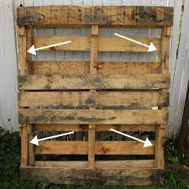

Outside welly storage on KS2 and on the building facing the field

Slide 6

Fairy garden
Mud kitchen
Willow tunnel
Trim trail
Wildflower meadow
Digging patch
Sandpit
Small world area (under KS1 window)
Pallet wellie storage
Reading shed
Staff room KS1 classroom
Field – (no football – used for playing to preserve the grass)

Slide 7
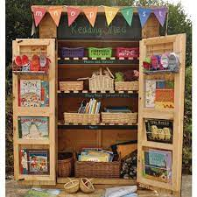
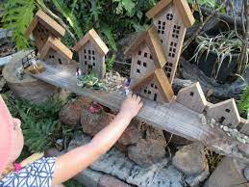
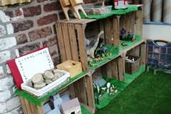
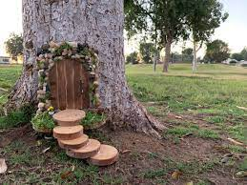
Field vision
Small world
Reading shed
Fairy garden

Slide 8

Trim trail
Flat area for wheels
Picnic benches for colouring / games benches with board games
Storage shed – crates / loose parts for play/ dressing up
Music boom box with music playing
KS1 playground
Field

Slide 9
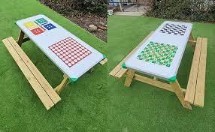
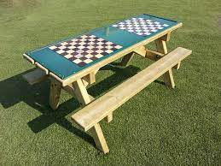
Games tables for KS1 playground

